Slide 1
YOLOv8 Object Detection, OCR, and Summarization Project
Suraj Kumar Jha •+91 8849083319

Slide 2
Overview
What is this project?
August 21, 2024
Key Points:
Object detection using YOLOv8.
Text extraction from segmented objects using Tesseract OCR.
Summarization of extracted text.
Visuals: A flowchart showing the step-by-step workflow:
Input Image →
YOLOv8 Detection →
Object Segmentation →
OCR Extraction →
Text Summarization →
Output CSV and Images.

Slide 3
Core Technologies
Header: Core Technologies and Tools
Key Points:
YOLOv8: State-of-the-art object detection.
Tesseract OCR: Open-source text recognition tool.
Summarization Algorithms: Simple text summarization for the extracted text.
Python Libraries: Pillow, pytesseract, pandas, etc.
.

Slide 4
How does it work?
Key Points:
1. Input Images: Users place images in the data/ folder.
2. Object Detection: YOLOv8 detects objects and segments them.
3. Text Extraction: Tesseract OCR extracts text from each segmented image.
4. Text Summarization: If the text is long enough, it is summarized.
5. Output: Segmented images and results saved in output/ as images and CSV.
.

Slide 5
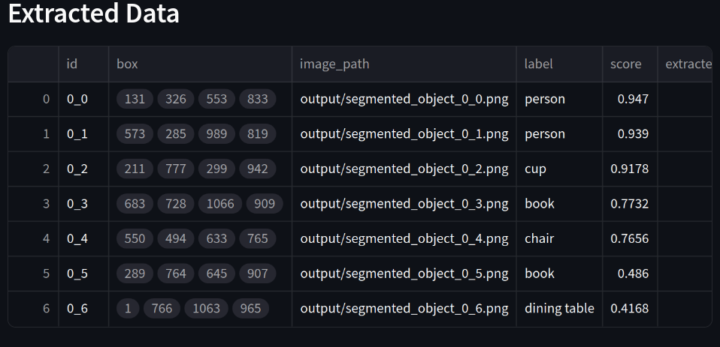
Results and outputs
Header: Outputs and Use Cases
Key Points:
Segmented Images: Cropped object images saved in the output/ folder.
CSV File: A CSV file (final_output_table.csv) containing object labels, extracted text, and summaries.
Use Cases: Useful in areas like document digitization, automated reporting, and intelligent surveillance.
Visuals: An example of segmented images and a screenshot of the CSV file. Add a brief bullet list of potential real-world applications.
CSV File

Slide 6
Output
.
.

Slide 7
Future Aspects
Key Points:
Optimizing the OCR and summarization pipeline for different languages and domains.
Expanding the model to detect and recognize complex objects and texts.
Conclusion: Summarize the project’s potential and its applicability in automation, AI, and data processing.

